Slide 1
Application Area

Slide 2
What is an Application Area? (1 of 2)
An application area is:
a collection of settings and resource files that are required to create the content of a business component.
a link between the component and its resources.
created using QTP and saved into QC.
not visible from the QC tree views as an asset or resource.
2
2
Notes:
Application area settings include general information about the application area, such as its name, description, associated QuickTest add-ins, and the applications on which associated components can run.
Application area resources include shared object repositories, function libraries, and so on. (You will learn about these types of resources in later topics.)
You store all of the resource files for an application area in Quality Center. To do this, you need to connect to a Quality Center project.
Depending on the application being tested, you may need to create one or multiple application areas. A good rule of thumb is to create one application area for each process that a Subject Matter Expert may need to test. (You may need to work with Subject Matter Experts to determine exactly what resources and settings are needed for each application area.)

Slide 3
What is an Application Area? (2 of 2)
Object Repository
Components
Function Libraries
Application
Area
Recovery Scenarios
Associated Add-ins
3

Slide 4
Associating an Application Area
Manual components are created in QC and are not associated with an
Application Area.
Scripted (automated) components must be associated with an Application Area.
Components are associated with only one Application Area.
A project can have multiple Application Areas.
4

Slide 5
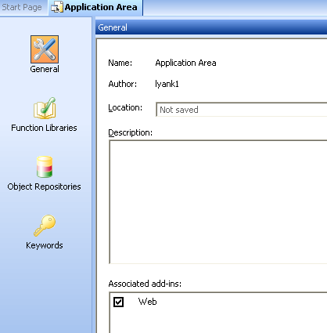
Creating an Application Area (1 of 3)
Launch QTP and connect to the desired QC project.
Open the Application Area window by selecting File > New > Application Area. The Application Area window contains several panes in which to specify the settings and resource files to be used by the Application Area.
5

Slide 6
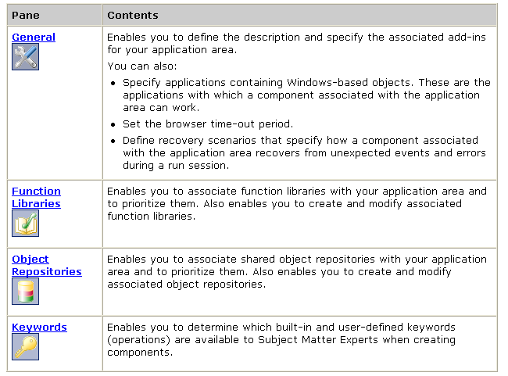
Creating an Application Area (2 of 3)
The Application Area contains the following panes which are accessed by clicking the appropriate button in the sidebar.
6

Slide 7
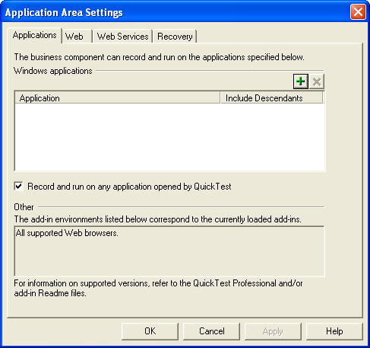
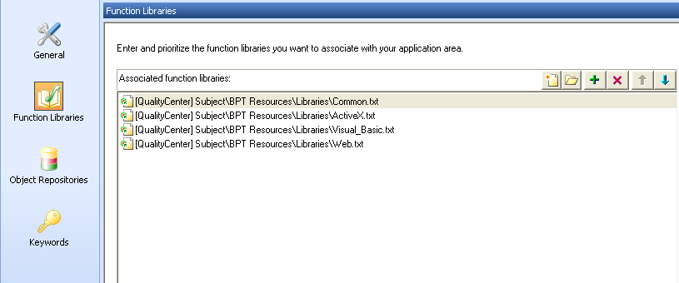
Creating an Application Area (3 of 3)
Specify the Application Area settings and define its resources.
Select File > Save to save the Application Area.
When saving an Application Area, assign a unique name and provide a description if not done previously. A meaningful name and description enable the Test Automation Engineer to select the correct Application Area for a component.
7

